Slide 1
2018 CODA 3: Mixed scale data processing and Interpretation of clusters over nominal features
Contents:
Scale types and quantification of categories
Data standardization and its effects
Nominal feature case
Contingency table
Category-to-category association by Quetelet
Chi-squared and normalization scale
Chi-squared and Quetelet
Homework 3

Slide 2
Quantification of categories: Illustrative Data case
Companies characterized by mixed scale features; first three companies making product A, next three making product B, and the last two product C.
Company name | Income, $mln | MShare,% | NSup | AA | Sector
Aversiona Antyops Astonite | 19.0 29.4 23.9 | 43.7 36.0 38.0 | 2 3 3 | No No No | Utility Utility Manufacture
Bayermart Breaktops Bumchista | 18.4 25.7 12.1 | 27.9 22.3 16.9 | 2 3 2 | Yes Yes Yes | Utility Manufacture Manufacture
Civiok Cyberdam | 23.9 27.2 | 30.2 58.0 | 4 5 | Yes Yes | Retail Retail

Slide 3
Company Dataset
Metadata: Object names, Features and Domain knowledge
1) Income, $ Mln;
2) MShare - Market share, per cent;
3) NSup - Number of principal suppliers;
4) Affirmative Action (AA) - Yes or No;
5) Sector - (a) Retail, (b) Utility, and (c) Manufacture.
Feature: Maps entities to feature values
(unlike variable in math. statistics or machine learning)
Quantitative scale: Arithmetic mean makes sense Examples: 1) Income, 2) MShare, 3) NSup
Binary scale: 1/0 coding makes it quantitative (mean=proportion)

Slide 4
Company Dataset
Metadata: Object names, Features and Domain knowledge
1) Income, $ Mln;
2) MShare - Market share , per cent;
3) NSup - Number of principal suppliers;
4) Affirmative Action (AA) - Yes or No;
5) Sector - (a) Retail, (b) Utility, and (c) Manufacture.
Feature: Maps entities to feature values
Quantitative scale: Arithmetic mean makes sense
Nominal scale: categories are exclusive, no relations (corresponds to partition of the set of objects in classes corresponding to categories)
Other scales (orders, non-alternative) not taken into account

Slide 5
Company dataset
Case 1: Companies 5
Company name | Income, $mln | MShare,% | NSup | AA | Sector
Aversiona Antyops Astonite | 19.0 29.4 23.9 | 43.7 36.0 38.0 | 2 3 3 | No No No | Utility Utility Manufacture
Bayermart Breaktops Bumchista | 18.4 25.7 12.1 | 27.9 22.3 16.9 | 2 3 2 | Yes Yes Yes | Utility Manufacture Manufacture
Civiok Cyberdam | 23.9 27.2 | 30.2 58.0 | 4 5 | Yes Yes | Retail Retail
Data analysis issues:
- How to map companies to the screen with their similarity reflected in distances between points? (Summarization/visualization)
- Would clustering of companies reflect the product? What features would be involved then? (Summarization)
- Can rules be derived to predict the product for another company, coming outside of the table? (Correlation)
- Is there any relation between the structural features (Nsup,AA,Sector) and market related features (Income, MShare)? (Correlation.)

Slide 6
Company Dataset: Quantification
Case 1: Companies 4
Company name | Income, $mln | MShare,% | NSup | AA | Sector
Aversiona Antyops Astonite | 19.0 29.4 23.9 | 43.7 36.0 38.0 | 2 3 3 | No No No | Utility Utility Manufacture
Bayermart Breaktops Bumchista | 18.4 25.7 12.1 | 27.9 22.3 16.9 | 2 3 2 | Yes Yes Yes | Utility Manufacture Manufacture
Civiok Cyberdam | 23.9 27.2 | 30.2 58.0 | 4 5 | Yes Yes | Retail Retail
Quantitative coding: Each category is made into a 1/0 binary (dummy) feature “Does it hold? 1 if Yes, 0 if No.”
Entity | Income | MShar | NSup | AA? | Util? | Manu? | Retail?
1 2 3 | 19.0 29.4 23.9 | 43.7 36.0 38.0 | 2 3 3 | 0 0 0 | 1 1 0 | 0 0 1 | 0 0 0
4 5 6 | 18.4 25.7 12.1 | 27.9 22.3 16.9 | 2 3 2 | 1 1 1 | 1 0 0 | 0 1 1 | 0 0 0
7 8 | 23.9 27.2 | 30.2 58.0 | 4 5 | 1 1 | 0 0 | 0 0 | 1 1
Company data 8×5 converted into quantitative format 8×7

Slide 7
Pre-processing: - quantification - filling in missings - standardization
Standardisation:
shift of the origin to compare data with a norm (a_{v})
rescaling to make features comparable
Y_{iv} = (X_{iv} –a_{v})/b_{v}
X - original data
Y – standardized data
a_{v} – shift of the origin, typically, the average
b_{v} – rescaling factor, traditionally the standard deviation (from statistics perspective), but range may be better

Slide 8
Company Dataset: Standardization
Company data 8×5 converted to the quantitative format 8×7
# | Inco | MSch | NSup | EC | Util | Indu | Reta
1 2 3 | 19.0 29.4 23.9 | 43.7 36.0 38.0 | 2 3 3 | 0 0 0 | 1 1 0 | 0 0 1 | 0 0 0
4 5 6 | 18.4 25.7 12.1 | 27.9 22.3 16.9 | 2 3 2 | 1 1 1 | 1 0 0 | 0 1 1 | 0 0 0
7 8 | 23.9 27.2 | 30.2 58.0 | 4 5 | 1 1 | 0 0 | 0 0 | 1 1
Three standardizations:
(i). (ii) and (iii)
Why are that many, and what is the need in data standardization?
Goal: to sharpen the data structure
# | Inco | MSch | NSup | AA | Util | Man | Reta
1 2 3 | 19.0 29.4 23.9 | 43.7 36.0 38.0 | 2 3 3 | 0 0 0 | 1 1 0 | 0 0 1 | 0 0 0
4 5 6 | 18.4 25.7 12.1 | 27.9 22.3 16.9 | 2 3 2 | 1 1 1 | 1 0 0 | 0 1 1 | 0 0 0
7 8 Mean | 23.9 27.2 22.45 | 30.2 58.0 34.12 | 4 5 3.00 | 1 1 .625 | 0 0 .375 | 0 0 .375 | 1 1 0.25
Data standardization in DA (unlike in Math. Stat.):
Feature centering: to look at feature values against a “normal” backdrop
Feature normalization: to balance feature weights

Slide 9
Company Dataset: Standardization (i)
-3.45 9.58 -1 -0.62 0.62 -0.38 -0.25
6.95 1.88 0 -0.62 0.62 -0.38 -0.25
1.45 3.88 0 -0.62 -0.38 0.62 -0.25
-4.05 -6.22 -1 0.38 0.62 -0.38 -0.25
3.25 -11.82 0 0.38 -0.38 0.62 -0.25
-10.35 -17.22 -1 0.38 -0.38 0.62 -0.25
1.45 -3.92 1 0.38 -0.38 -0.38 0.75
4.75 23.88 2 0.38 -0.38 -0.38 0.75
Structure of data at standardization (i): just centering
Color/shape corresponds
to the product (A,B,C)
This structure has nothing to do with product

Slide 10
Company Dataset: Standardization (ii)
-0.20 0.23 -0.33 -0.62 0.62 -0.38 -0.25
0.40 0.05 0 -0.62 0.62 -0.38 -0.25
0.08 0.09 0 -0.62 -0.38 0.62 -0.25
-0.23 -0.15 -0.33 0.38 0.62 -0.38 -0.25
0.19 -0.29 0 0.38 -0.38 0.62 -0.25
-0.60 -0.42 -0.33 0.38 -0.38 0.62 -0.25
0.08 -0.10 0.33 0.38 -0.38 -0.38 0.75
0.27 0.58 0.67 0.38 -0.38 -0.38 0.75
Structure of data at standardization (ii), centering and normalizing by range
Color/shape correspond to the product (A,B,C)
This structure somewhat corresponds to product

Slide 11
Company Dataset: Standardization (iii)
-0.20 0.23 -0.33 -0.62 0.36 -0.22 -0.14
0.40 0.05 0 -0.62 0.36 -0.22 -0.14
0.08 0.09 0 -0.62 -0.22 0.36 -0.14
-0.23 -0.15 -0.33 0.38 0.36 -0.22 -0.14
0.19 -0.29 0 0.38 -0.22 0.36 -0.14
-0.60 -0.42 -0.33 0.38 -0.22 0.36 -0.14
0.08 -0.10 0.33 0.38 -0.22 -0.22 0.43
0.27 0.58 0.67 0.38 -0.22 -0.22 0.43
Structure of data at standardization (iii): (ii)+ further normalizing
Sector features by sqrt(3)
Color/shape corresponds to the product (A,B,C)
This structure corresponds
to product quite well !

Slide 12
Interpretation of nominal feature
Interpretation of a quantitative feature v
v
cluster S_{k} c_{kv} within-cluster mean
c_{v}
Compare c_{kv} – c_{v} (absolute),
(c_{kv} – c_{v})/c_{v}= c_{kv} /c_{v} – 1 (relative) – interpret !!!

Slide 13
Cluster interpretation
Center c_{k} for Interpretation of cluster S_{k}:
Iris taxon T1: Specimens number 1, 2, …, 50
Taxon T1 Interpretation: SMALL PETAL
 | SLength | SWidth | PLength | PWidth
Center | 5.006 | 3.428 | 1.462 | 0.246
Grand mean | 5.843 | 3.057 | 3.758 | 1.199
Difference | −0.837 | 0.371 | −2.296 | −0.953
Difference, % | −14.3 | +12.1 | −61.1 | −79.5
This is c_{kv} /c_{v} – 1, per cent!

Slide 14
Nominal feature interpretation,1
Category v quantified: Category v
1 0
2 1
N objects … …
i 1
… …
N 0
Average p_{v}
- proportion of v

Slide 15
Nominal feature interpretation, 2
Category v quantified: Average: p_{v} - proportion of v
Category v within cluster S_{k} with | S_{k} |= N_{k} objects
i1 0
i2 1
N_{k} objects … …
ij 1
… …
N_{k} 0
Average: p(v/k) - proportion of v in S_{k} = probability [relative frequency] of v under condition S_{k}

Slide 16
Nominal feature interpretation, 3a
Category v quantified: Average: p_{v} - proportion of v
Within-cluster average:
p(v/k) - proportion of v in S_{k} = probability [relative frequency] of v under condition S_{k}
Interpretation, full analogy to the quantitative case: the center of S_{k} at v relates to the mean of v:
I_{kv}=[p(v/k) - p_{v}]/p_{v} = p(v/k)/p_{v}-1

Slide 17
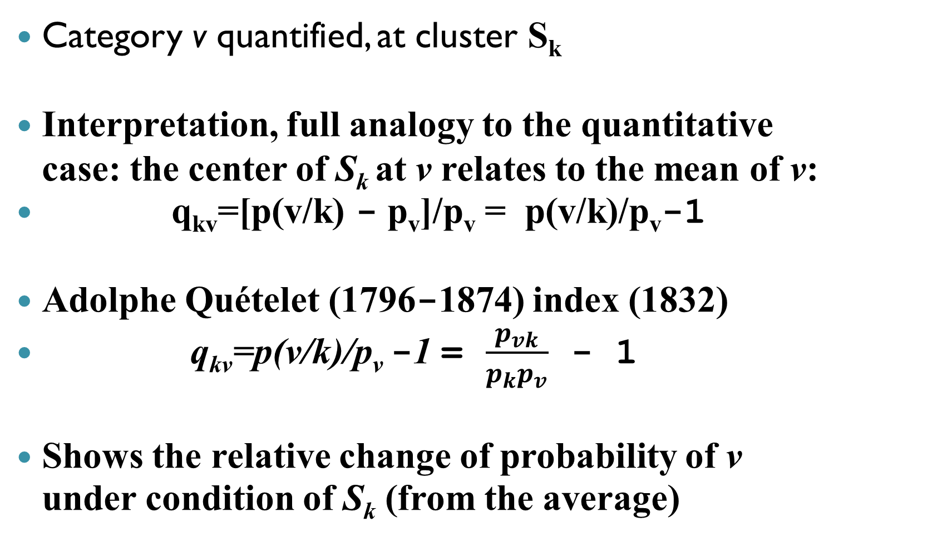
Nominal feature interpretation, 3b
Category v quantified, at cluster S_{k}
Interpretation, full analogy to the quantitative case: the center of S_{k} at v relates to the mean of v:
q_{kv}=[p(v/k) - p_{v}]/p_{v} = p(v/k)/p_{v}-1
Adolphe Quételet (1796-1874) index (1832)
q_{kv}=p(v/k)/p_{v} -1 = $\frac{p_{vk}}{p_{k}p_{v}}$ - 1
Shows the relative change of probability of v under condition of S_{k} (from the average)

Slide 18
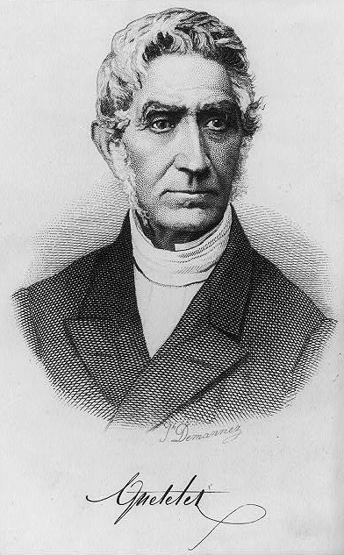
Lambert Adolphe Jacques Quetelet (22.02.1796 – 17.02.1874, Belgium), founding father of social statistics

Slide 19
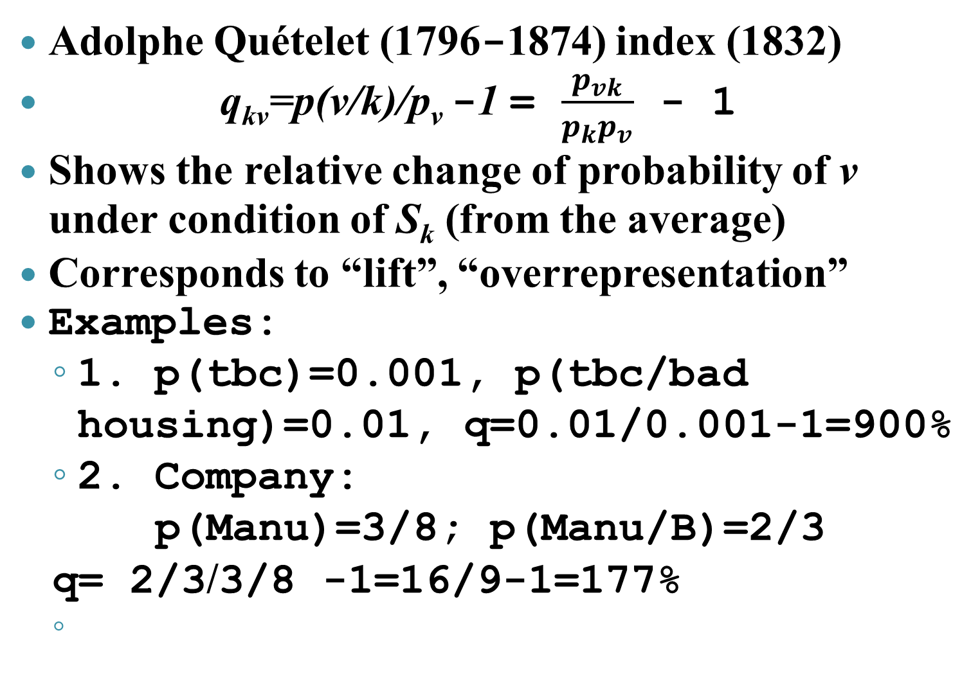
Nominal feature interpretation, 3c
Adolphe Quételet (1796-1874) index (1832)
q_{kv}=p(v/k)/p_{v} -1 = $\frac{p_{vk}}{p_{k}p_{v}}$ - 1
Shows the relative change of probability of v under condition of S_{k} (from the average)
Corresponds to “lift”, “overrepresentation”
Examples:
1. p(tbc)=0.001, p(tbc/bad housing)=0.01, q=0.01/0.001-1=900%
2. Company:
p(Manu)=3/8; p(Manu/B)=2/3
q= 2/3/3/8 -1=16/9-1=177%

Slide 20
Nominal feature case, 4
Category v quantified: Average: p_{v} - proportion of v
Dummy v standardized: subtracting a_{v}= p_{v}, dividing by b_{v}
Within-cluster average:
p(v/k) probability of v under condition S_{k}
After standardization, the center of S_{k} at v:
c_{kv}=[p(v/k) - p_{v}]/b_{v}=[p_{vk} -p_{v}p_{k}]/[b_{v}p_{k}]
p_{vk} = N_{vk} /N, p_{k} = N_{k} /N,
N_{vk} is the number of ones in S_{k} over category v

Slide 21
Nominal feature case, 5
Dummy v standardized: subtracting a_{v}= p_{v}, dividing by b_{v}
Within-cluster average:
p(v/k) probability of v under condition S_{k}
After standardization, the center of S_{k} at v:
c_{kv}=[p(v/k) - p_{v}]/b_{v}=[p_{vk} -p_{v}p_{k}]/[b_{v}p_{k}]
//p_{vk} = N_{vk} /N, p_{k} = N_{k} /N,
Contribution of category v and cluster S_{k} to the data scatter:
N_{k} c_{vk}² = N[p_{vk} -p_{v}p_{k}]² /[b_{v}² p_{k}]

Slide 22
Nominal feature case, 6
Dummy v standardized: subtracting a_{v}= p_{v}, dividing by b_{v}
Contribution of category v and cluster S_{k} to the data scatter:
N_{k} c_{vk}² = N[p_{vk} -p_{v}p_{k}]² /[b_{v}² p_{k}]
At b_{v} = 1, N_{k} c_{vk}² = N[p_{vk} -p_{v}p_{k}]² / p_{k}
At b_{v} = (p_{v})^{½} , N_{k} c_{vk}² = N[p_{vk} -p_{v}p_{k}]² /[p_{v}p_{k}]

Slide 23
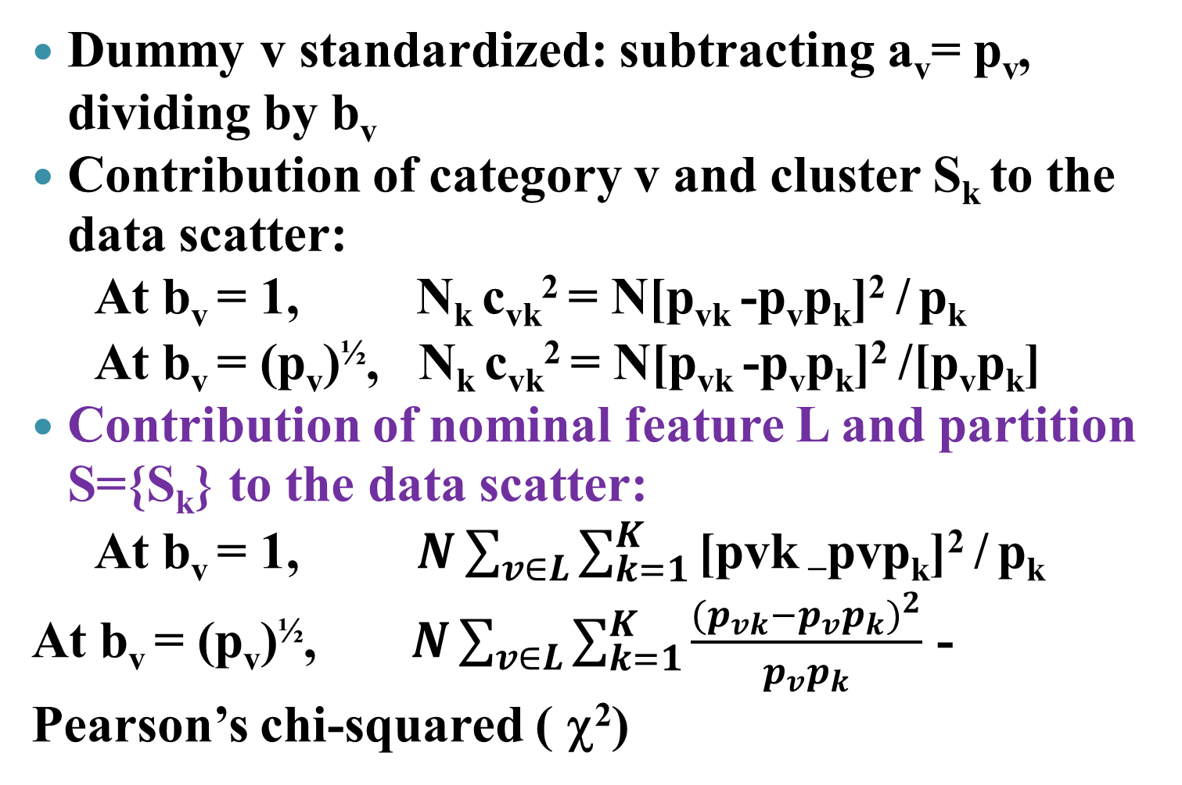
Nominal feature case, 7
Dummy v standardized: subtracting a_{v}= p_{v}, dividing by b_{v}
Contribution of category v and cluster S_{k} to the data scatter:
At b_{v} = 1, N_{k} c_{vk}² = N[p_{vk} -p_{v}p_{k}]² / p_{k}
At b_{v} = (p_{v})^{½}, N_{k} c_{vk}² = N[p_{vk} -p_{v}p_{k}]² /[p_{v}p_{k}]
Contribution of nominal feature L and partition S={S_{k}} to the data scatter:
At b_{v} = 1, $N\sum_{v∈L}{\sum_{k=1}^{K}{\text{[}\text{pvk}\text{ −}\text{pvp}\text{k}\text{]}\text{2} \text{/} \text{p}\text{k}}}$
At b_{v} = (p_{v})^{½}, $N\sum_{v∈L}{\sum_{k=1}^{K}{\frac{{(p_{vk}−p_{v}p_{k})}^{2}}{p_{v}p_{k}}}}$ -
Pearson’s chi-squared ( χ²)

Slide 24
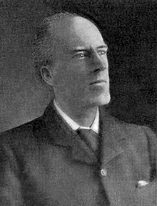
Karl Pearson (27 March 1857 – 27 April 1936, UK), founding father of data analysis and mathematical statistics

Slide 25
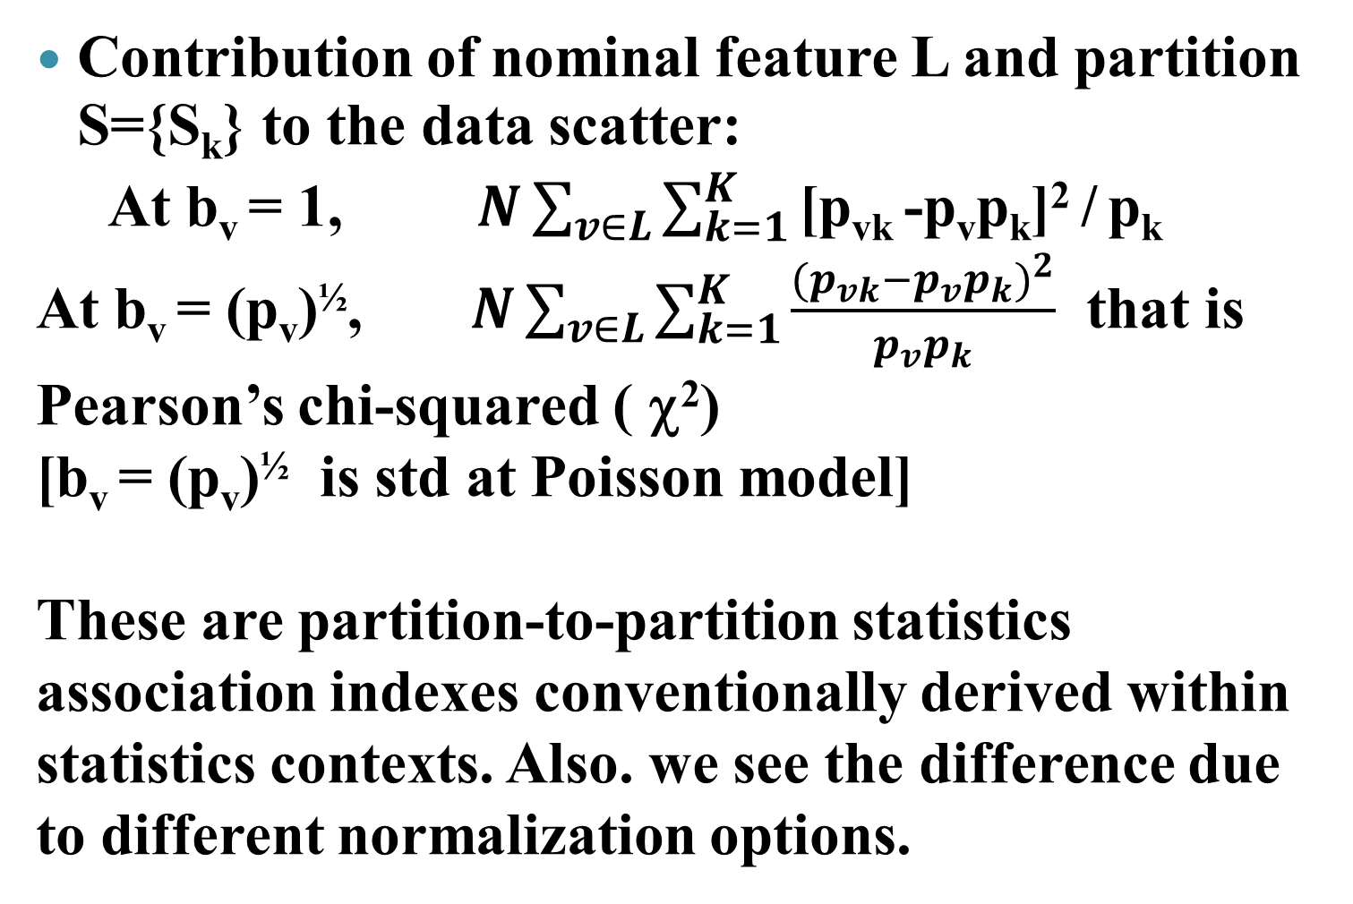
Nominal feature case, 8
Contribution of nominal feature L and partition S={S_{k}} to the data scatter:
At b_{v} = 1, $N\sum_{v∈L}{\sum_{k=1}^{K}{\text{[}\text{pvk}\text{ −}\text{pvp}\text{k}\text{]}\text{2} \text{/} \text{p}\text{k}}}$
At b_{v} = (p_{v})^{½}, $N\sum_{v∈L}{\sum_{k=1}^{K}{\frac{{(p_{vk}−p_{v}p_{k})}^{2}}{p_{v}p_{k}}}}$ that is
Pearson’s chi-squared ( χ²)
[b_{v} = (p_{v})^{½} is std at Poisson model]
These are partition-to-partition statistics association indexes conventionally derived within statistics contexts. Also. we see the difference due to different normalization options.

Slide 26
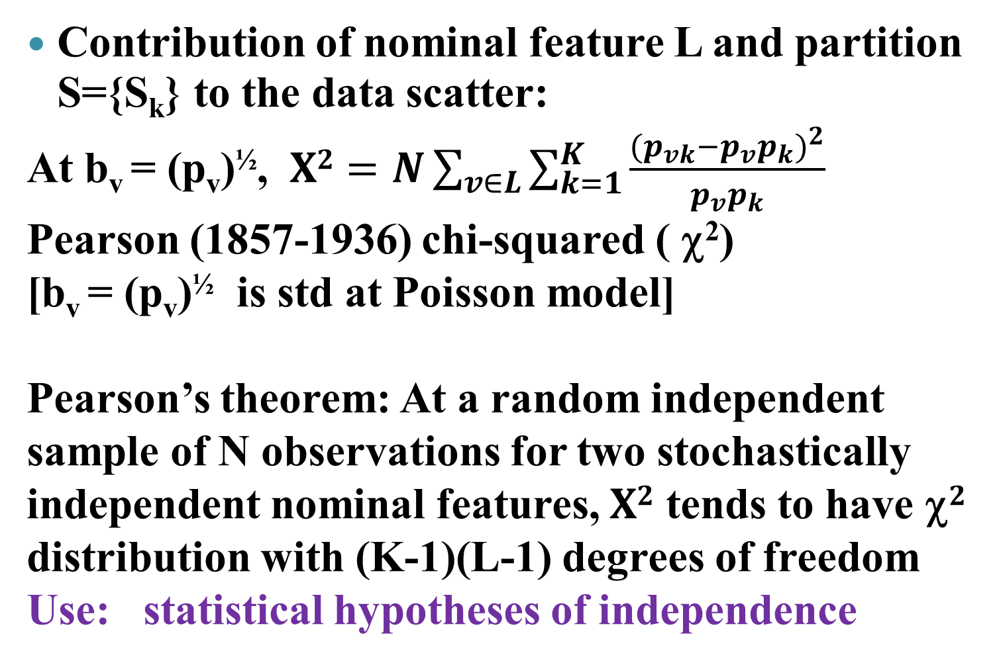
Nominal feature interpretation, 9
Contribution of nominal feature L and partition S={S_{k}} to the data scatter:
At b_{v} = (p_{v})^{½}, $X2=N\sum_{v∈L}{\sum_{k=1}^{K}{\frac{{(p_{vk}−p_{v}p_{k})}^{2}}{p_{v}p_{k}}}}$
Pearson (1857-1936) chi-squared ( χ²)
[b_{v} = (p_{v})^{½} is std at Poisson model]
Pearson’s theorem: At a random independent sample of N observations for two stochastically independent nominal features, $X2$ tends to have χ$2$ distribution with (K-1)(L-1) degrees of freedom
Use: statistical hypotheses of independence

Slide 27
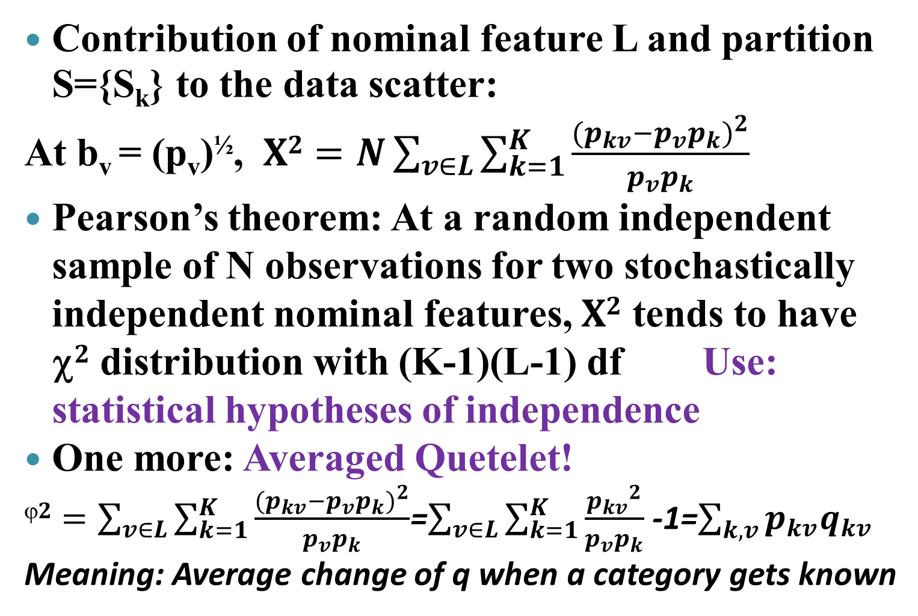
Nominal feature interpretation, 10
Contribution of nominal feature L and partition S={S_{k}} to the data scatter:
At b_{v} = (p_{v})^{½}, $X2=N\sum_{v∈L}{\sum_{k=1}^{K}{\frac{{(p_{kv}−p_{v}p_{k})}^{2}}{p_{v}p_{k}}}}$
Pearson’s theorem: At a random independent sample of N observations for two stochastically independent nominal features, $X2$ tends to have χ$2$ distribution with (K-1)(L-1) df Use: statistical hypotheses of independence
One more: Averaged Quetelet!
$2=\sum_{v∈L}{\sum_{k=1}^{K}{\frac{{(p_{kv}−p_{v}p_{k})}^{2}}{p_{v}p_{k}}}}$=$\sum_{v∈L}{\sum_{k=1}^{K}{\frac{{p_{kv}}^{2}}{p_{v}p_{k}}}}$ -1=$\sum_{k, v}{p_{kv}q_{kv}}$
Meaning: Average change of q when a category gets known

Slide 28
Lecture contents*
Scale types and quantification of categories
Data standardization and its effects
Nominal feature case
Contingency table
Conditional frequencies
Category-to-category association by Quetelet
Chi-squared and normalization of dummies
Chi-squared and Quetelet
Homework 3
*All the contingency table notions are considered in the Appendix Material in a greater detail

Slide 29
Homework 3: Contingency Table
Consider three nominal features (one of them, not more, may be taken from nominal features in your data)
Build two contingency tables over them: present a conditional frequency table and Quetelet relative index tables. Make comments on relations between categories of the common (to both tables) feature and two others.
Compute and visualize the chi-square-summary_Quetelet_index over both tables. Comment on the meaning of the values in the data analysis context.
Tell what numbers of observations would suffice to see the features as associated at 95% confidence level; 99% confidence level.

